Slide 1
Tutorial –2 Last tutorial before PE2

Slide 2


Slide 3
Tutorial 10 Xiao Liang's Tutorial Group
5 November 2018
https://github.com/yxliang01/cs1010-fun-stuff

Slide 4
Problem 25.1

Slide 6
void solve(long k, long source, long dest, long placeholder) {
if (k == 1) {
print(k, source, dest);
}
else {
solve(k - 1, source, placeholder, dest);
print(k, source, dest);
solve(k - 1, placeholder, dest, source);
}
}

Slide 7
Only allowed to move a disk either to Peg B from another peg or from Peg B to another peg.

Slide 8
Solution

Slide 9
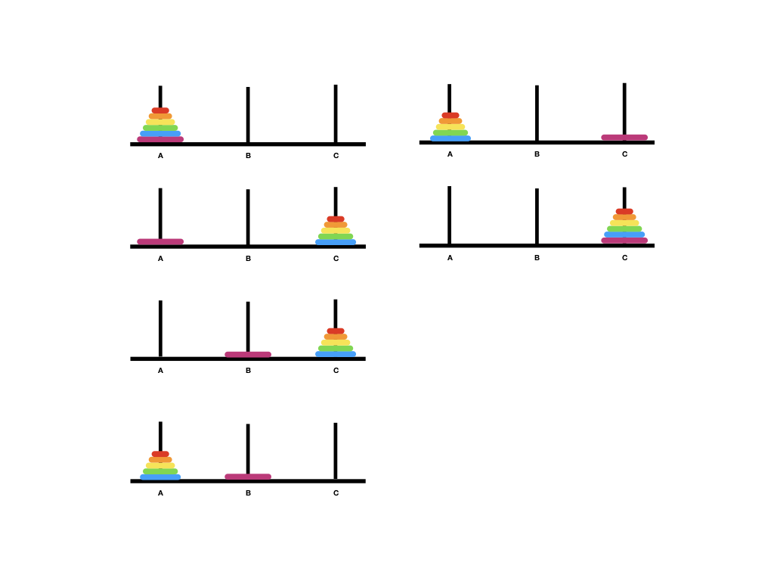

Slide 10
void solve(long k, long source, long dest, long placeholder) {
if (k == 1) {
move(k, source, placeholder);
move(k, placeholder, dest);
return;
}
solve(k - 1, source, dest, placeholder);
move(k, source, placeholder);
solve(k - 1, dest, source, placeholder);
move(k, placeholder, dest);
solve(k - 1, source, dest, placeholder);
}

Slide 11
Problem 26.1

Slide 12
Code given in lecture
permutate recursively
a
b
c
b
e
b
a
c
b
e
c
b
a
b
e
b
b
c
a
e
duplicate work!
e
b
c
b
a

Slide 13
Avoid generating duplicate permutations when the input string contains duplicate characters

Slide 14
void permute(char a[], long len, long curr) {
if (curr == len-1) {
cs1010_println_string(a);
return;
}
permute(a, len, curr + 1);
for (long i = curr + 1; i < len; i += 1) {
if (...) { // Line A
swap(a, curr, i);
permute(a, len, curr + 1);
swap(a, i, curr);
}
}
}

Slide 15
Solution

Slide 16
Code given in lecture
permutate recursively
a
b
c
b
e
b
a
c
b
e
c
b
a
b
e
check before recurse:
has it appeared before?
if so, skip
a
b
c
b
e
e
b
c
a
a

Slide 17
a[k]
a[i]
a
b
c
b
e
bool appear_before(char a[], long k,
long i) {
for (int j = k; j < i; j += 1) {
if (a[j] == a[i]) {
return true;
}
}
return false;
}

Slide 18
void permute(char a[], long len, long curr) {
if (curr == len-1) {
cs1010_println_string(a);
return;
}
permute(a, len, curr + 1);
for (long i = curr + 1; i < len; i += 1) {
if (!appear_before(a, curr, i)) { // Line A
swap(a, curr, i);
permute(a, len, curr + 1);
swap(a, i, curr);
}
}
}

Slide 19
Fun Stuff

Slide 20
Uh?

Slide 21


Slide 22
Problem 27.1

Slide 23
void nqueens(char queens[], long n, long row) {
if (row == n-1) {
if (!threaten_each_other_diagonally(queens, n)) {
cs1010_println_string(queens);
}
return;
}
if (!threaten_each_other_diagonally(queens, row)) {
nqueens(queens, n, row + 1);
}
for (long i = row + 1; i < n; i++) {
swap(queens, row, i);
if (!threaten_each_other_diagonally(queens, row)) {
nqueens(queens, n, row + 1);
}
swap(queens, row, i);
}
}

Slide 24
bool threaten_each_other_diagonally(char queens[], long len) {
for (long i = 0; i < len; i += 1) {
// for each queen in row i, check rows i+1 onwards,
// on both left (-=1) and right (+=1) side, if there
// is a queen in that column.
if (has_a_queen_in_diagonal(queens, len, i)) {
return true;
}
}
return false;
}

Slide 25
Identify the repetitive work being done in the calls threaten_each_other_diagonally. Suggest a way to remove the repetitive work.

Slide 26
Solution

Slide 27
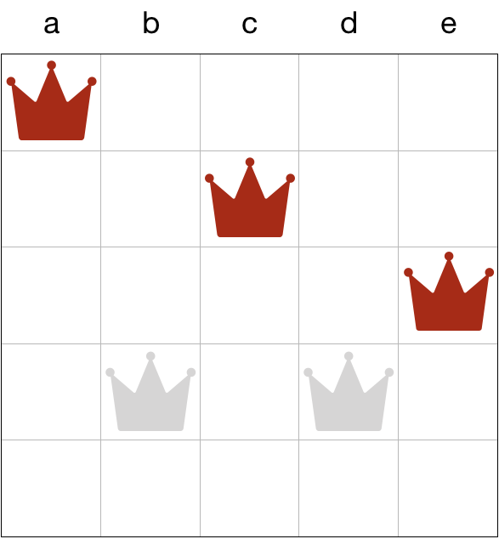
Already “safe.”
No need to check
again.
Only check the new
row against the queens
above.

Slide 28
Problem 27.2

Slide 29
void permute(char a[], long len, long curr) {
if (curr == len-1) {
cs1010_println_string(a);
return;
}
permute(a, len, curr + 1);
for (long i = curr + 1; i < len; i += 1) {
if (!appear_before(a, curr, i)) { // Line A
swap(a, curr, i);
permute(a, len, curr + 1);
swap(a, i, curr);
}
}
}

Slide 30
Restrict the permutations to those where the same character does not appear next to each other.

Slide 31
void permute(char a[], long len, long curr) {
if (curr == len-1) {
cs1010_println_string(a);
return;
}
permute(a, len, curr + 1);
for (long i = curr + 1; i < len; i += 1) {
if (!appear_before(a, curr, i)) { // Line A
swap(a, curr, i);
permute(a, len, curr + 1);
swap(a, i, curr);
}
}
}

Slide 32
Solution

Slide 33
Prune away generation of permutations where the same characters appear next to each other.

Slide 34
void permute(char a[], long len, long curr) { if (curr == len-1) {
if (a[curr] != a[curr-1]) {
cs1010_println_string(a);
}
return;
}
if (a[curr] != a[curr-1]) {
permute(a, len, curr + 1);
}
for (long i = curr + 1; i < len; i += 1) {
if (!appear_before(a, curr, i) && a[i] != a[curr-1]) {
swap(a, curr, i);
permute(a, len, curr + 1);
swap(a, i, curr);
}
}
}

Slide 35
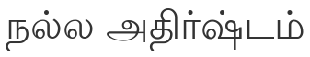
Good Luck (English)
祝你好运 (华语，Mandarin)
祝你好运 (闽南语, Hokkien)
祝你好運 (廣東話, Cantonese)
Semoga Berjaya (Bahasa Melayu, Malay)
Semoga Berhasil(Bahasa Indonesia)
(தமிழ், Tamil)
? (हिन्दी, Hindi)
がんばろう（日本語, Japanese）

Slide 36
This slide is at
https://github.com/yxliang01/cs1010-fun-stuff/blob/master/tutorial-slides/tut10-xl.pptx
PDF version
https://github.com/yxliang01/cs1010-fun-stuff/blob/master/tutorial-slides/tut10-xl.pdf

Slide 37
Q&A

